Slide 1
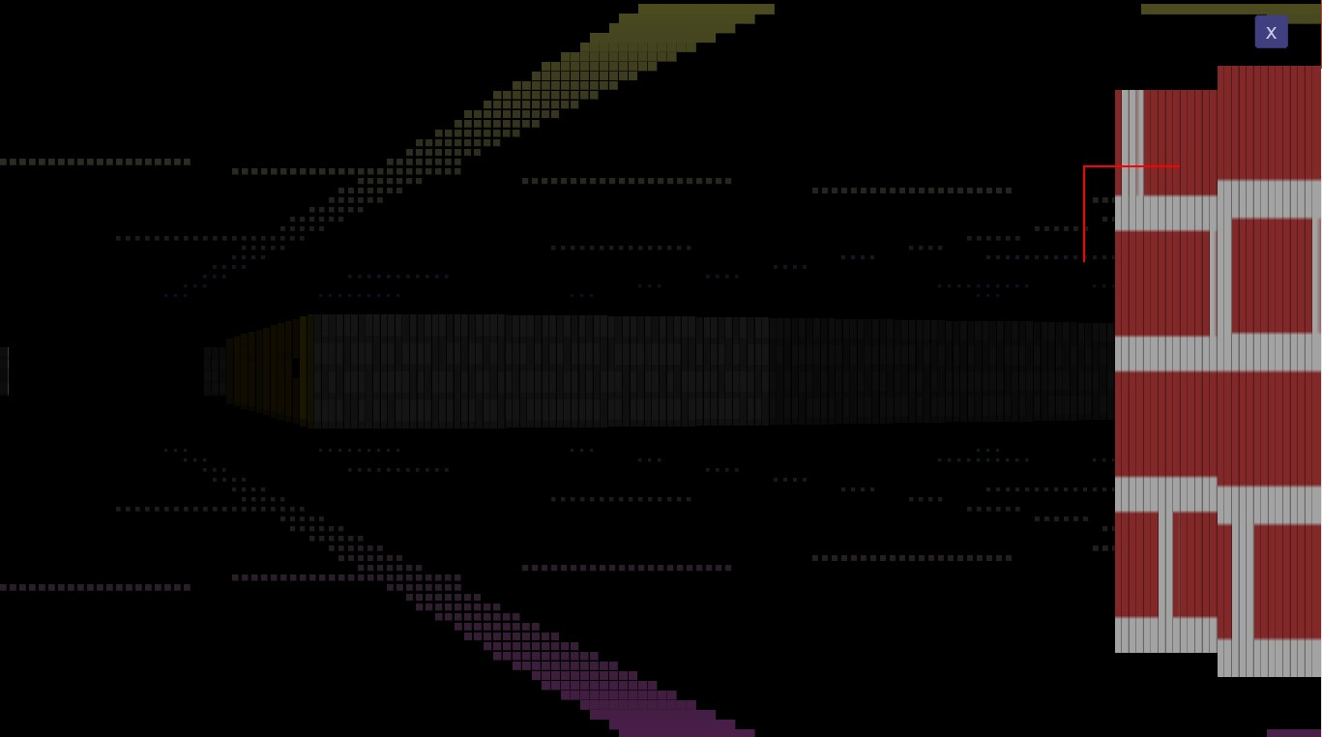
Mystic Chambers
JavaScript Pitch
Lead: Bilal A. Cheema
8th March to 28th June (16 Weeks or 4 Months)
Notes:
Welcome to Mystic Chambers, a JavaScript Pitch. I am Bilal and I am the team lead. I have decided to give this game, development period of 4 months or 16 weeks.

Slide 2

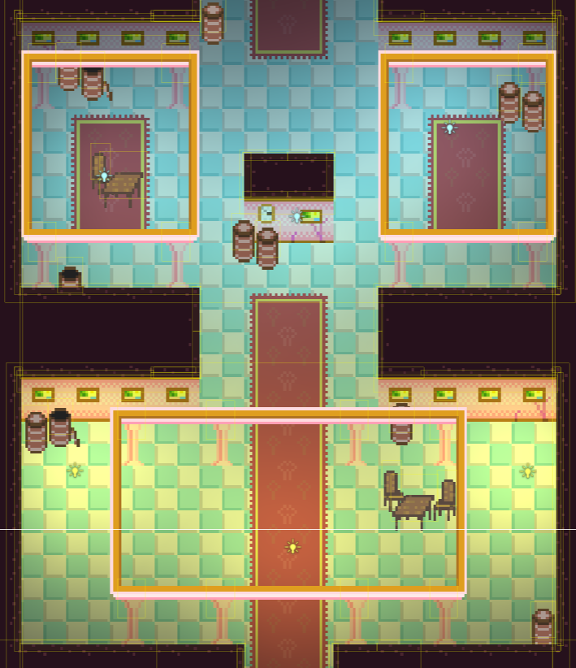
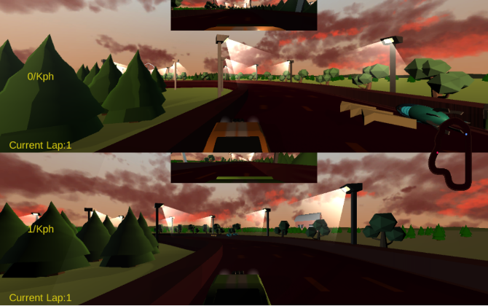
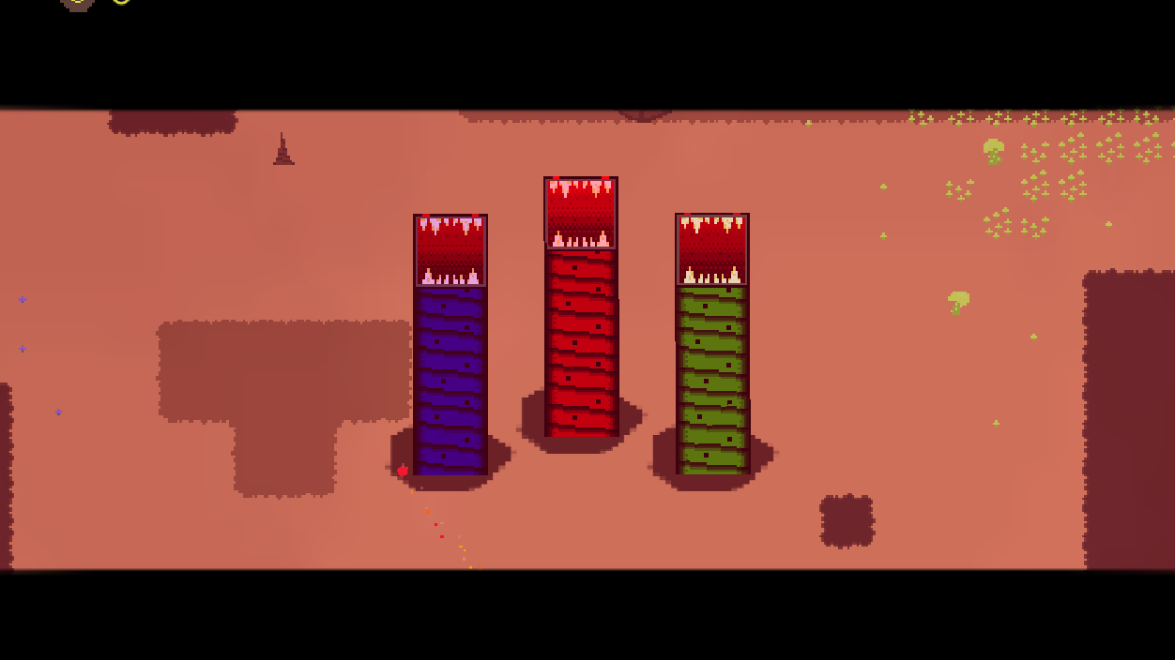

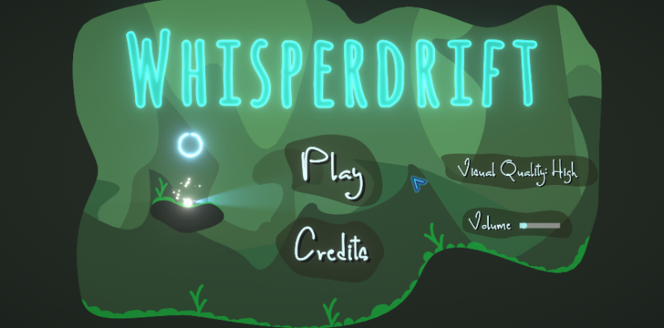
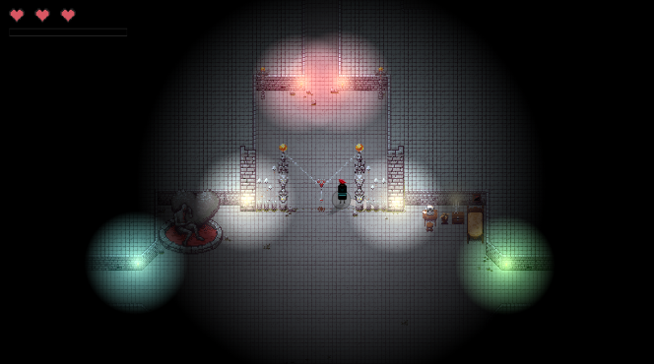
My Experience
Made Small Games with C++, SDL2, JavaFX and Unity.
Contributed to 7 Club Games: WhisperDrift, Wild Drivers, Delv, Alien Overrun, Exit the Shadow, Ghost Rustlers, Nethercard Kingdom.
Led a Unity 2D Game called Nick Of Time
Notes:
I have plenty experience with gamedev especially SDL2 and Unity. I have contributed to 7 club games before and led Nick Of Time. I have mostly done Unity stuff in the club and JavaScript has never been my focus here until this pitch.

Slide 3
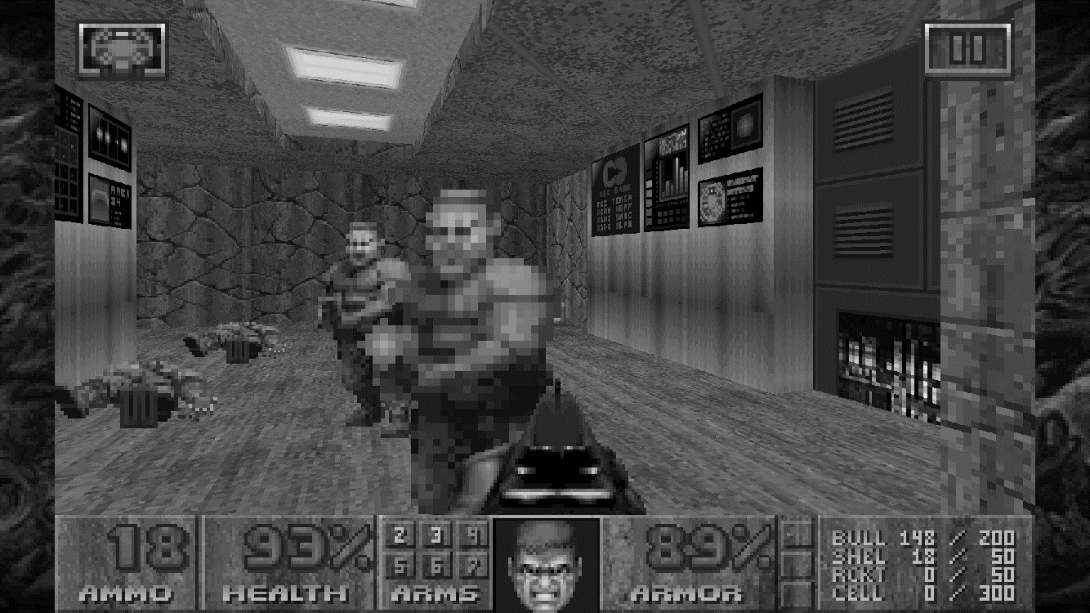
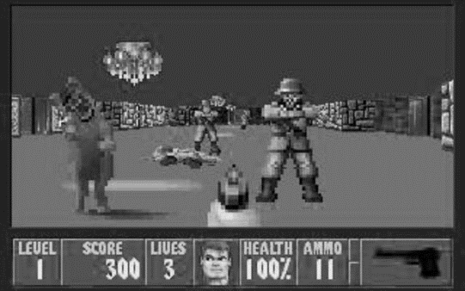
Inspirations
Definitely, Doom II
But will look more like Wolfenstein 3D because we will be using raycast 3D unlike Doom which uses BSP.
Notes:
My top inspiration is Doom II but Mystic Chambers would be more similar to Wolfenstein 3D except that we will try to add more to it. It fascinates me to make a raycaster game and understand how the game works behind the scenes without the triangles and polygons. That is why I opted for JavaScript rather than Unity.

Slide 4
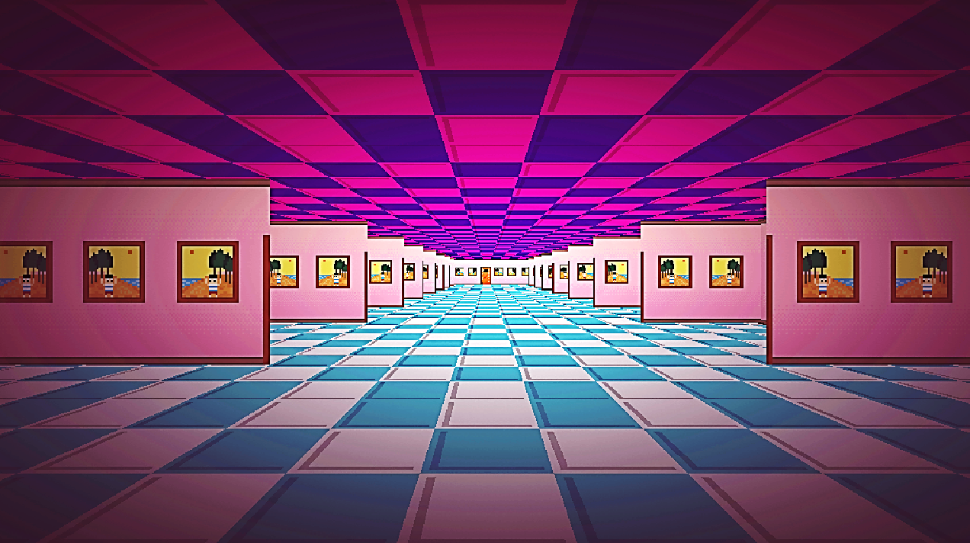
I want to get better in…
Talk-to-Camera and Video Editing Skills (I won’t be live in most of the weekly meetings; most of them will be recorded videos)
Problem Solving Skills
Cooperation and Team Work
Finishing-Game Skill
Level Design and Puzzle Elements
Notes:
I try my best to make sure that I learn more along the way as well as give opportunity to others to learn as well. This time, I want to get better in talk-to-camera and video editing skills because recently, I have been thinking of starting a YouTube channel in my native language, Urdu. I might start an English channel once I feel like I am doing good in my Urdu YouTube channel. And also, that means it will be recorded videos in most of the weekly meetings. The thing is, during my previous club game, Nick Of Time, it was summer vacations which means that I can stay up late at night and I don’t have to go to medical college in the early morning. But this time, there are no vacations except in the last 2 to 3 weeks of development and the meeting time is quite uncomfortable for me.
I feel like this game will be more of a programming challenge which means that it is a great opportunity to get better at problem solving skills. Cooperation and team work always plays a key role in the GameDev world. Communicating the changes in the codebase, making sure that the team is working towards the right direction, motivating the members to join the team despite the possibilities of uneasy development and at the same time, making it easy for the team to contribute in the game are the key points that I am focusing at. Other than that, I still find it hard to finish a game and there is a lot to learn when it comes to level design.

Slide 5
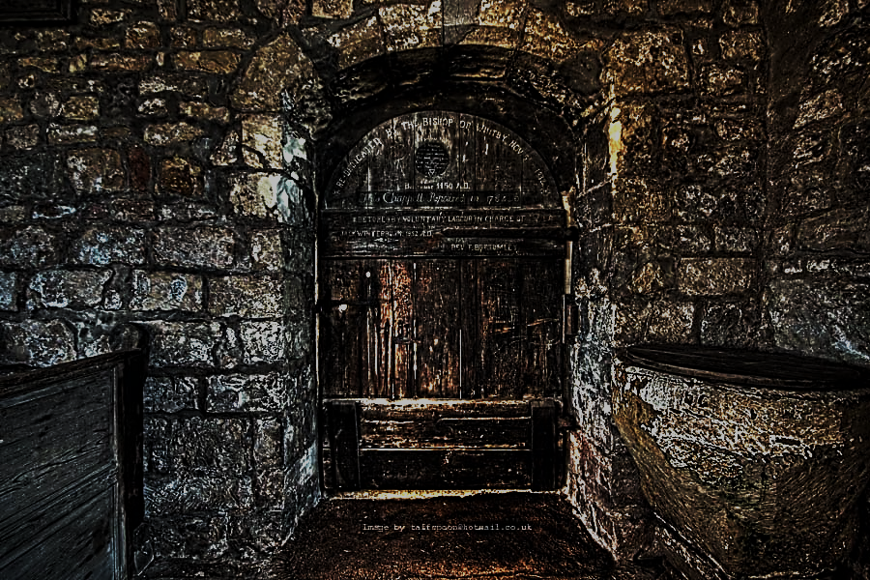
Let’s enter the Mystic Chambers!
Notes:
So, let us enter the ‘prototypia’ of Mystic Chambers. By the way, local server is required to run the game. In case, you don’t know how to run the game on local server, I have given the instructions in the Trello board. This is the map mode or control panel mode. Here you can see the editor where you can edit the level. Here, the lines are walls and there texture is indicated by the color. Origin of blue rays is the player. Green boxes are the collision areas. Diagonal walls are possible but diagonal collision areas are not possible as of now. Definitely a lot to do especially programming. I recommend you to try clicking all the stuff in here and change all kinds of values to see how it affects the game. Also, the UI is quite buggy as of now. Hopefully, it will work fine for you.
And if you click on the cross button at the top right corner, you will be in the exciting part of the game, the play mode. Here, you can see the 3D that is generated via the raycasting of the rays. Basically, each ray generates a segment of wall and its height is determined by the length of the ray before it reaches that wall segment. Outcast group is also developing similar game called GlacierBound. I must say, what a coincidence! 3D raycaster is a genre that (according to Chris) is never developed in the club before and now, 2 games of the same nature are being developed at the same time.

Slide 6
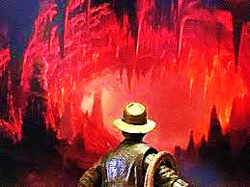
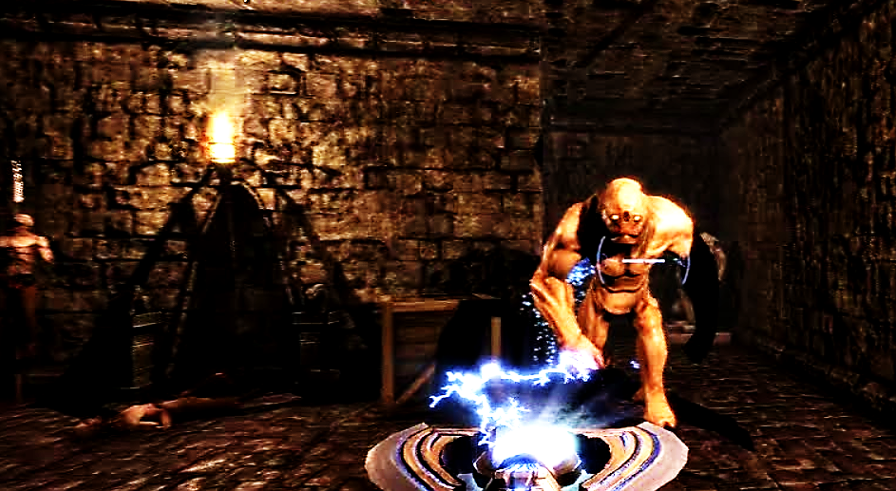
Minimal Objectives
Raycast 3D Dungeon Crawler
16X16 Dark Pixel Art scaled to 160X160 (there are exceptions like Guns)
Basic Storyline: To find Mystus Treasure. But there are enemies, traps and puzzles. Old Rusty Guns. Complete 6 Levels and get to it.
6+ Items, 2+ Guns, 3+ Enemies, 14+ Décor, 8+ Walls.
Notes:
So, minimal objectives. This time I am really keeping it short. Raycast 3D Dungeon Crawler. 16 by 16 Dark Pixel Art which is scaled 10 times otherwise it would be blurry. If there is a solution to this problem, we can revert back to 1 times scaling. There are definitely exceptions to it like the guns. They would probably be 64 by 64.
The storyline is simple. The player wants to find the Mystus Treasure. Similar to Indiana Jones or Tomb Raider. It will be dark underground environment. The levels will be floors of the chamber and the player will go deeper with each level. I would like to have old rusty guns. Basically, capturing the feeling of Dark, Old and Rusty. Level editor is already on the way so making levels will be pretty easy. 6 levels and not too many items. The focus is to make less but good.

Slide 7
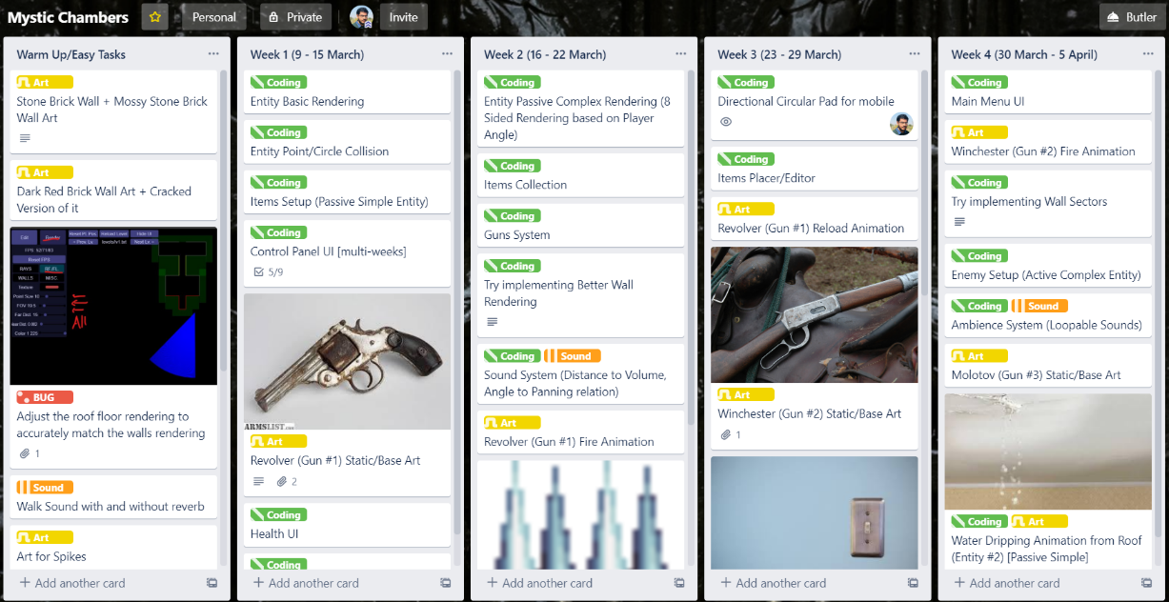
Schedule
Notes:
Let us take a look at the schedule. There is this Docs/Help section where I have answered some of the questions to help you understand my custom code. You can add a card in this section with your question and I will try to answer it as clearly as possible. This will also help other team members. I personally think that having a docs/help section is much better as compare to a separate text file or documents. The warm up tasks contains a lot of art and sound.
In the first 2 weeks, we will be implementing entities. From entities, I meant all the things other than walls, areas and rays. For example, items and enemies.
In the next 5 weeks, we will be implementing fire skull, evil dwarf, druid, health box, adrenaline, key/door system, portals, ladders and some more stuff like that.
By the end of week 7, we would have accomplished the minimal objectives of the game except for the levels. If we did the tasks a lot earlier than expected, I might add more to the schedule.
From 8th week to 11th week, I would be busy in Medical CBA Examinations so, I would be doing a lot less. Ofcourse, my team would be doing a lot of tasks done during these weeks.
The remaining 12th to 16th weeks would be focused towards boss functionality, level design, bug fixes and tons of polish.
As you can clearly notice, there is a lot of buffer. And that is because I am a bit unsure whether I would be able to do JavaScript the way as Unity. Of course, it is really different. But with the help of the team and Chris office hours, I am sure we will be able to manage it just fine.

Slide 8
Programming (JavaScript)
Entity Rendering (Simple – 1 image, all sides; Complex – 8 images, 1 image for each side based on player angle)
Entity Point Collision
Items System
Inventory System
Guns System
Gameplay UI (HP Bar, Bullets Count)
Sound System
Items Placer/Editor
Main Menu UI
Wall Sectors
Enemy Setup
Enemies: Fire Skull, Evil Dwarf, Druid
Ambience System
Enemy Interaction (Movement, Bullet-Enemy, Enemy-Player)
Key-Door System (like Doom 2)
Improved Wall Rendering
Wall Switch
Notes:
So, here are most of the programming tasks. This game requires a lot of programming and so, it is a perfect opportunity to hone your programming skills. You would get into the depths of pseudo 3D. There are two things that I am particularly interested in how entities are going to be implemented and how the enemy interaction will work. Other than that, that there is still a whole lot to dive into.

Slide 9
Art (Dark Pixel Art; mostly 16X16)
Stone Brick Wall + Mossy version of it
Dark Red Brick Wall + Cracked version of it
Guns Static, Shoot and Reload: Revolver, Winchester, Molotov
Fire Animation
Spikes
Key/Door
Health Box
White Pearl
Injection
Pillar
Water Dripping Animation
Enemies Idle, Walk, Attack: Fire Skull, Evil Dwarf, Druid
Notes:
We are going for low resolution pixel art. Enemies and some items need to have 8 sprites to cover Entity Complex Rendering (or you can say 8-Sided Rendering). Therefore, low resolution make sense to make it easier for artists and animators. The art style is very dark much like that of Doom II or Heretic. A lot of varieties of walls to look at and dark gruesome enemies are definitely something that this game needs.

Slide 10
Audio (Dark Ambience; Creepy Sounds)
Walk sound (with and without reverb)
Guns Reload and Shoot sounds: Revolver, Winchester, Molotov
Fire
Water Dripping
Enemies Idle, Move, Attack sounds: Fire Skull, Evil Dwarf, Druid
Ghostly Wind Ambience
Notes:
Recently, I added more sounds in the Trello that I haven’t covered in this slide. There are a lot of sounds and this game is all about dark atmosphere and dark ambience. So, we need all the audible darkness.

Slide 11
Who’s in? Questions?
Thank you for listening!
Notes:
So, who’s in? Any questions regarding Mystic Chambers? Also, thanks to all for listening.

